Slide 1
Having fun with my brother and sisters
(A special story for Carter Boeke)

Slide 2
I have a lot of brothers and sisters!
I have two brothers, Ethan and Aidan.
I have two sisters, Julia and Madeleine.
I have a puppy, Harper.
Julia and Ethan are older than me.
Aidan and Madeleine are younger than me.
I am the middle child.

Slide 3
Some things I do with my brothers and sisters.
I go to the beach with them.
We play in the pool together.
We play with Harper together.
Sometimes we play games as a family.
We cook in the kitchen together.
Sometime I learn new games with them.

Slide 4
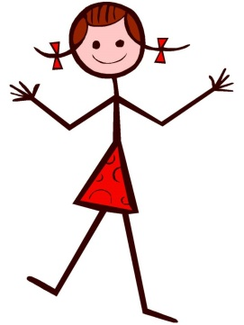
There are many games to play like Sorry, and Uno. I can learn new games too. They make me think. Playing games with another person can be fun. We are both playing the same game and following the same directions.
I have a sister named Claire. She is 10 years old. We play games together if we both know the same game. Sometimes we play computer games and sometimes we play board games. We play games at home and sometimes in the car.
Me too. Let’s play!
I know the rules to that game.

Slide 5
Usually when you play games, one person will win. Everyone likes to win. I like to win. Claire likes to win. My friends like to win.
Sometimes I win. When I win, I might say, “I won but you might win next time.”
Sometimes other people win. This is okay. I could say, “Good game. I hope I win next time.”
Even though it is hard to lose, I know I will win sometimes and my friends or sister will win other times.
I won. But you might win next time.
Good game! I hope I win next time

Slide 6
All games have rules. When I play a game with another person, it is important to follow the rules of the game. This helps both of us have a good time. It makes it the same for both of us. It is fair. It feels good to win the game by following the rules!
Changing the rules or making up new rules, is cheating. For instance, I can’t roll a 1 on the dice and say it is a 6. This is changing the rules so I can win. Cheating makes the people I play a game with mad. Rules are what make the game fun and I can’t change them unless Claire and I BOTH say it is okay.
It’s no fun when he changes the rules.
That’s against the rules.
I’m moving my man over here.

Slide 7
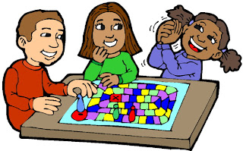
When we play games, it is more fun when we all play by the rules. Sometimes I will win and sometimes I will lose. When I loose, I can remember that it makes my friend or sister happy to win and I might win next time. This way we all have a chance to win!

